Slide 1
Explore Careers and Plan Your Future
With RUReady.ND.gov
INTEREST PROFILER

Slide 2
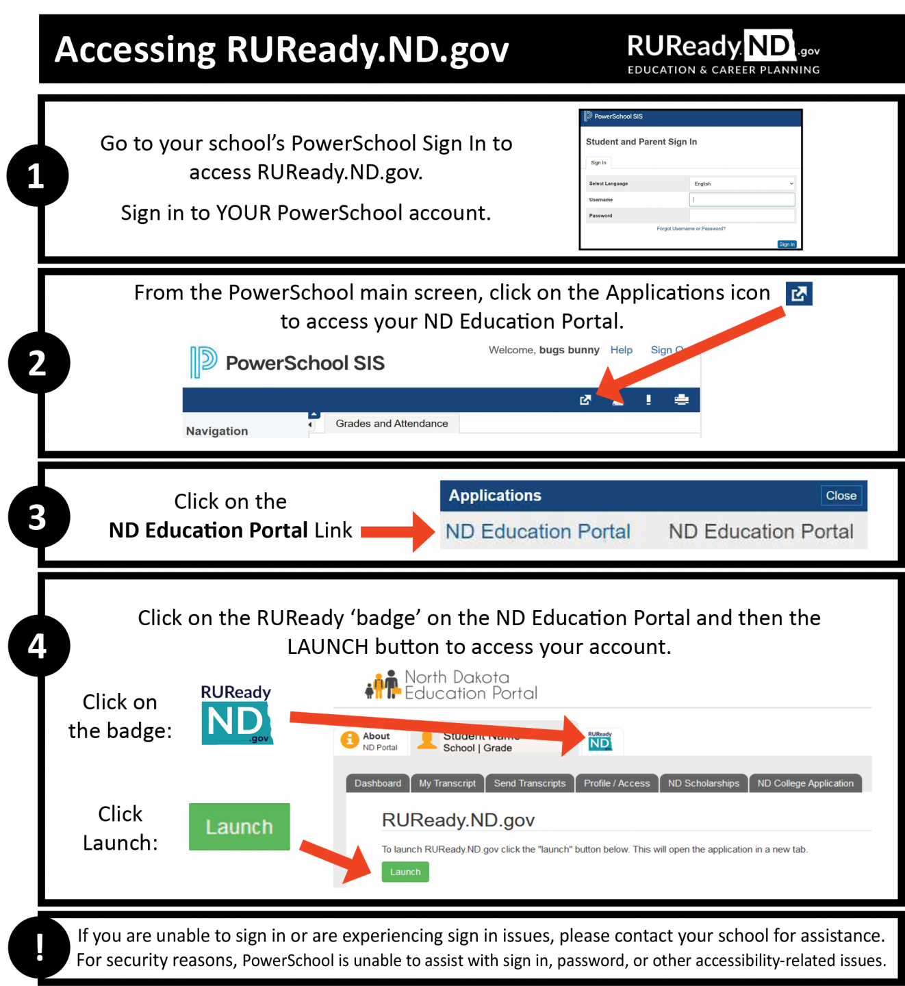
How do I access RUReady.ND.gov?
PUBLIC SCHOOL student in grades 6-12:
I’m a PRIVATE or TRIBAL SCHOOL student in grades 6-12:
Go to RUReady.ND.gov.
Click Create an Account.
Click on the role that best describes you (Middle School or High School Student.)
Enter your name and date of birth and select your school and graduation year.
Select your Account Name and Password with care. You will use this to access the site.
Complete the Account Security questions.
Check the box if you agree to the privacy policy and terms of the site.
Click Submit.
Full Instructions for Public School students. | Full Instructions for Private/Tribal School students.
Notes:
*If you are experiencing sign in issues, please contact your school for assistance. For security reasons, PowerSchool is unable to assist with sign in, password, or other accessibility-related issues.
(You will receive your account username and password from your school.)

Slide 3
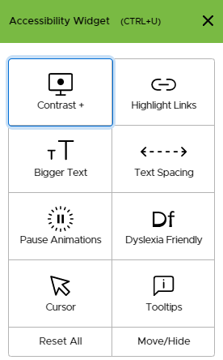
The UserWay Widget
The UserWay widget offers assistance with the following:
Contrast
Highlight Links
Bigger Text
Text Spacing
Pause Animations
Dyslexia Friendly
Cursor
Tooltips
Click on the green UserWay icon in the in upper right-hand corner of the screen to select accessibility tools.
Notes:
Mention this feature if you have students who would benefit from it.

Slide 4
Find the Interest Profiler
Click on the CAREER PLANNING tab.

Slide 5
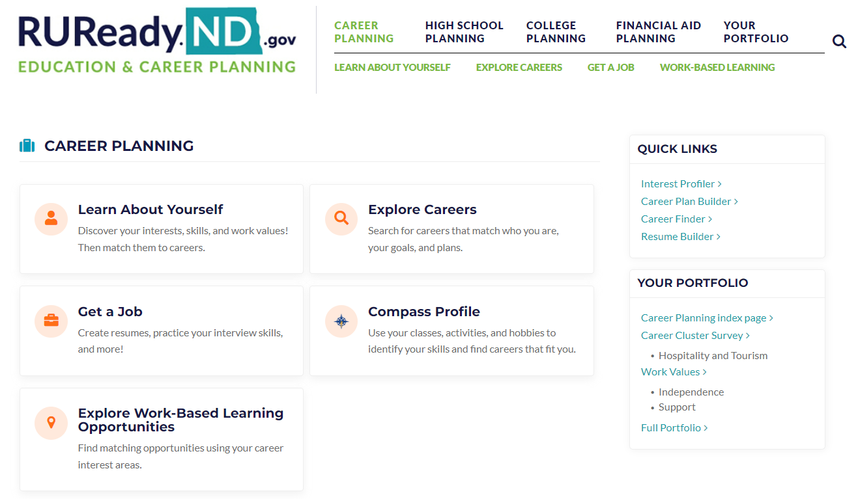
Click on Learn About Yourself.

Slide 6
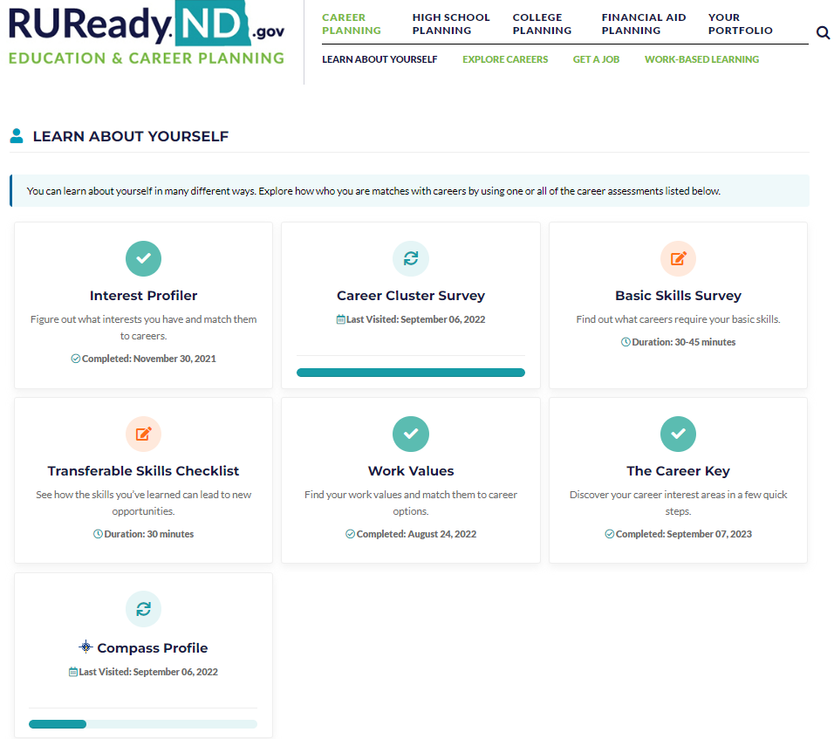
Click on Interest Profiler

Slide 7
Click on
GET STARTED

Slide 8
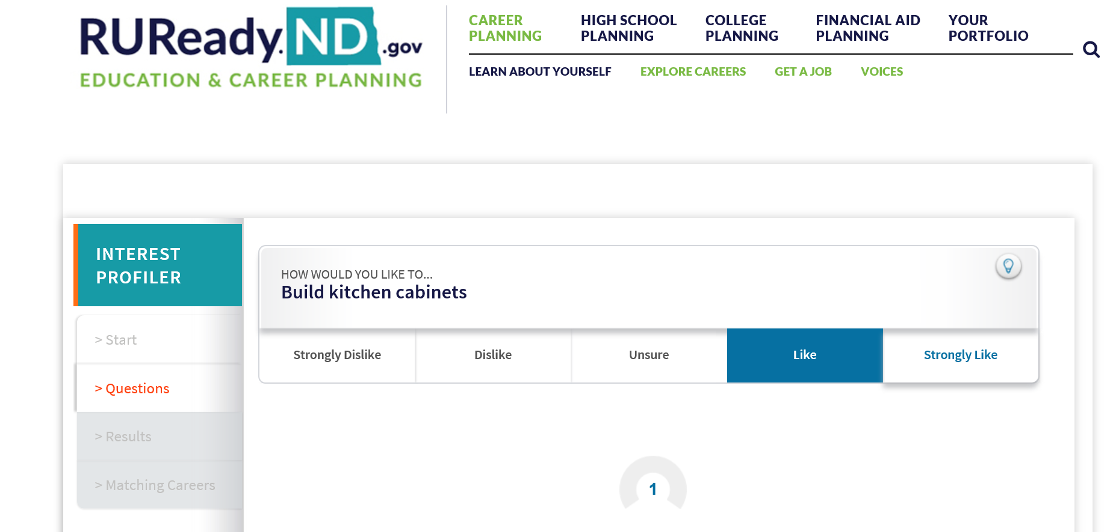
Answer the Questions

Slide 9
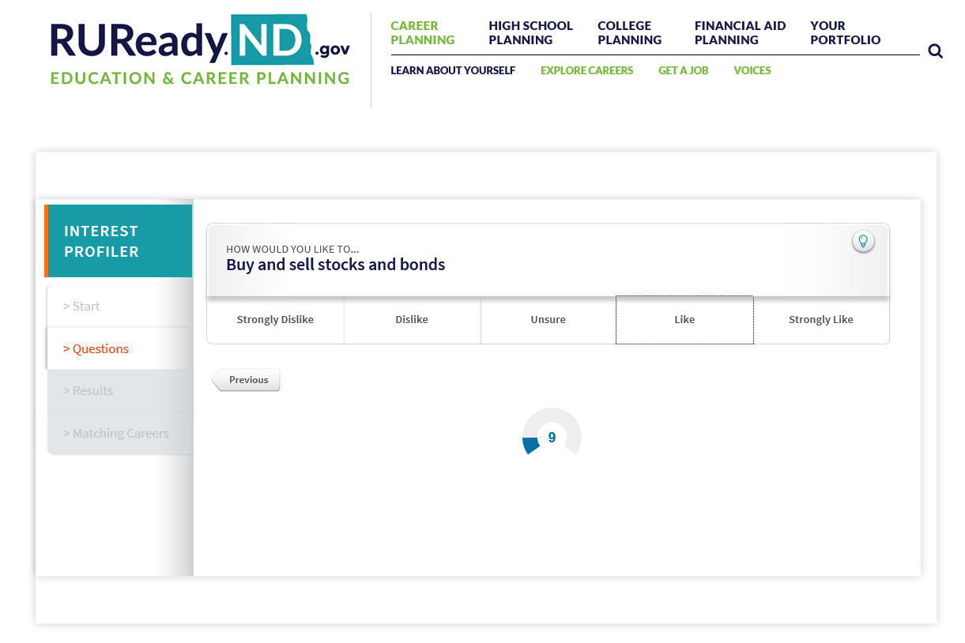
Tracks Your Progress

Slide 10
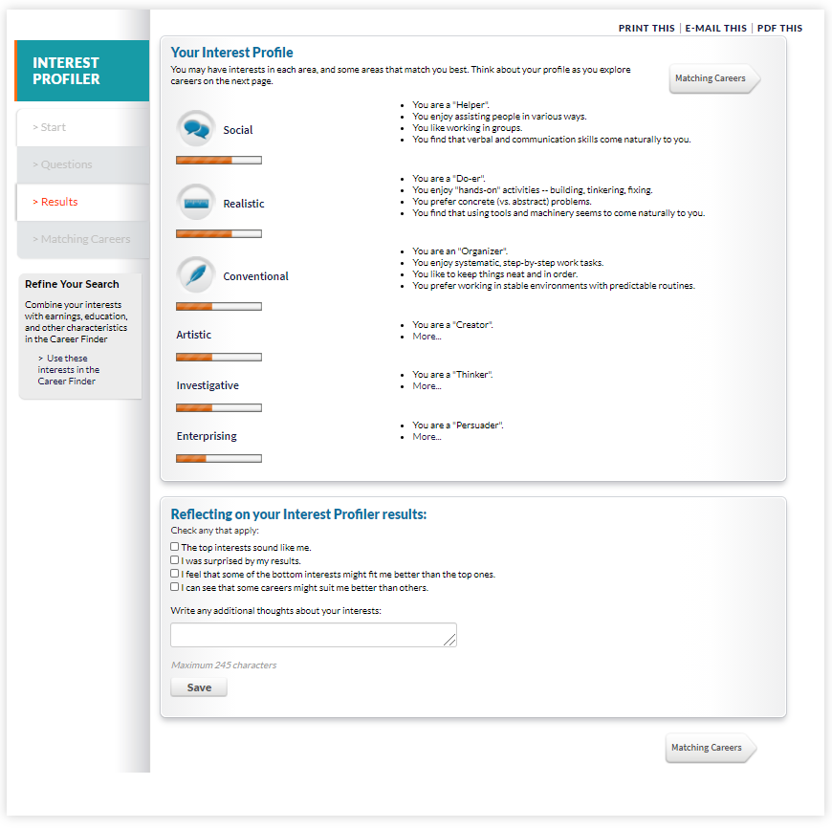
Your Interest Profile

Slide 11
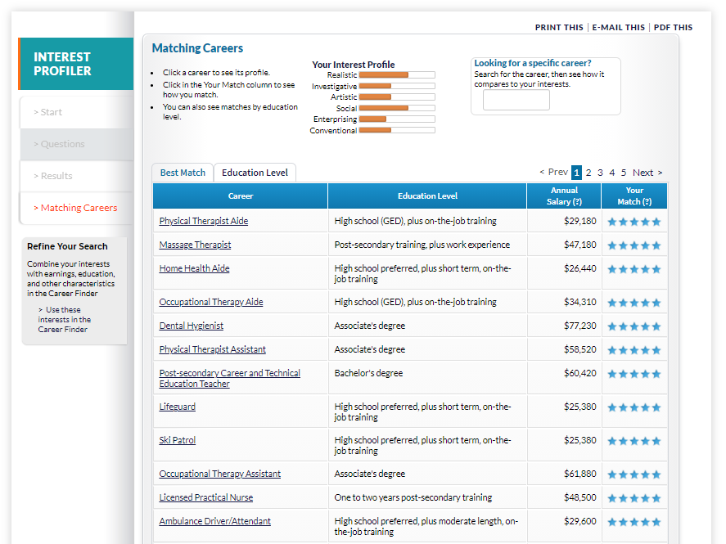
Refine Your Search
Use your interests to search for careers in the Career Finder.

Slide 12
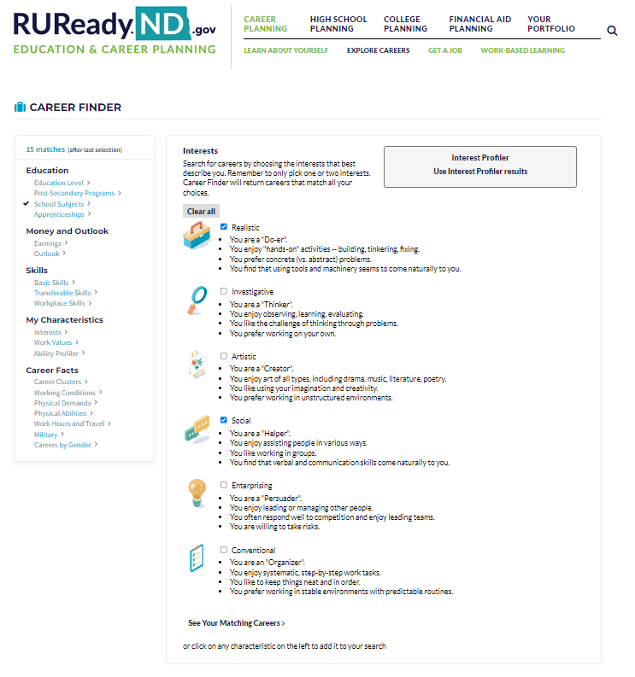
Click See Your Matching Careers or click on any characteristic on the left to add it to your search.

Slide 13
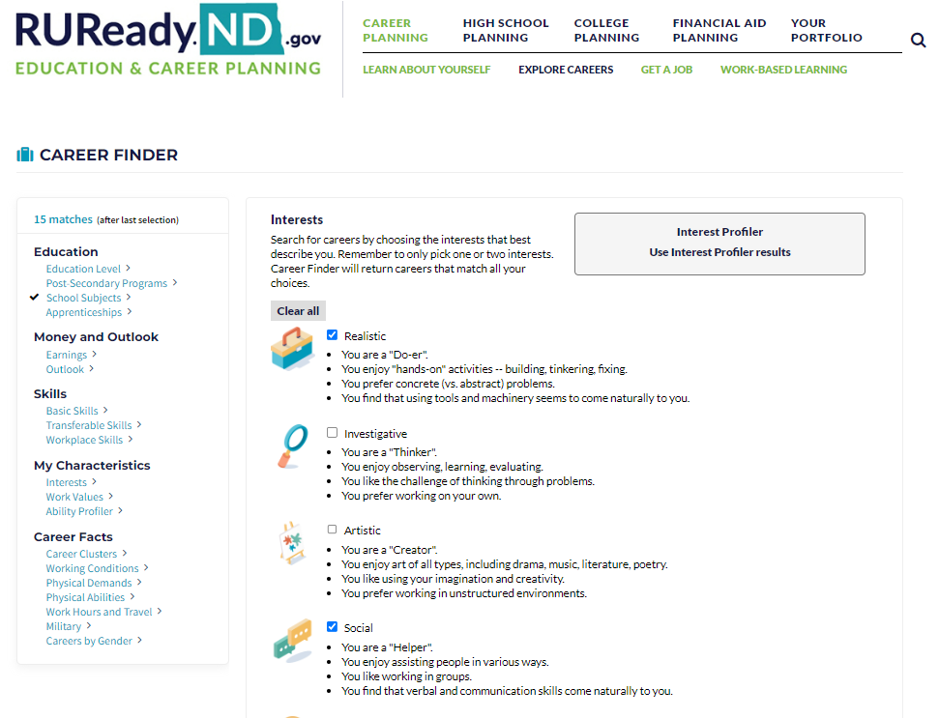
Click on Education Level

Slide 14
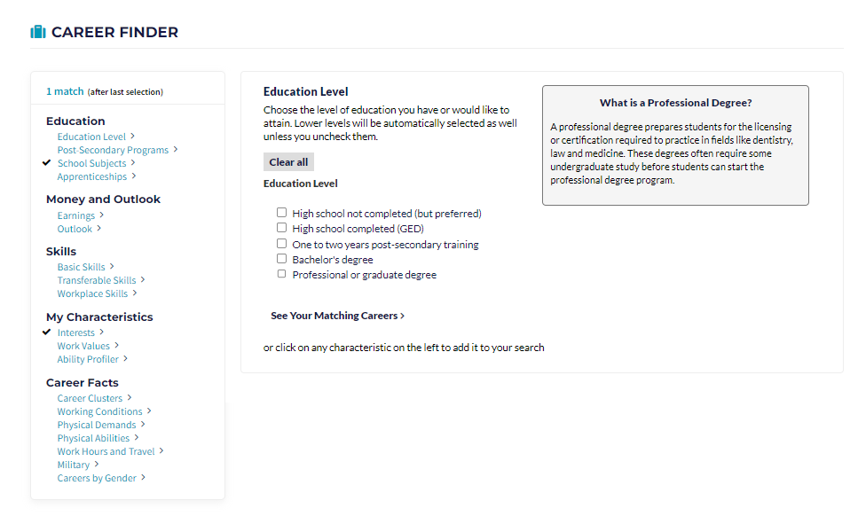
Education Level Choose the level you HOPE to achieve.
Click on See Your Matching Careers

Slide 15
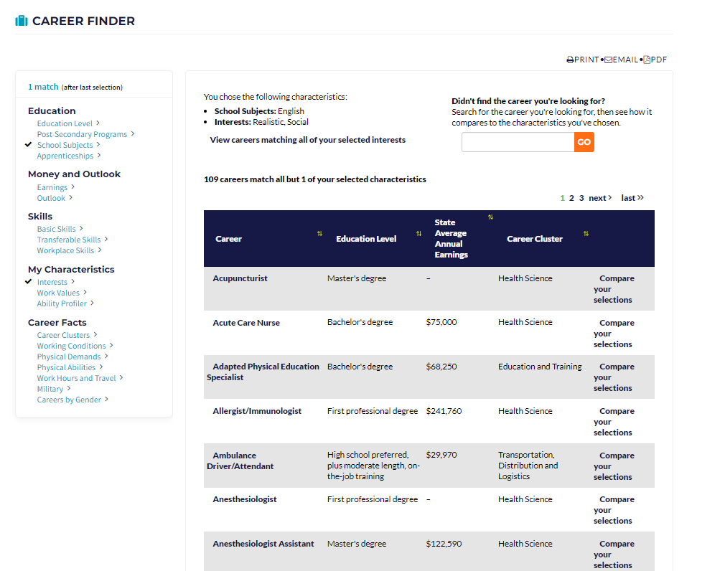
Sort by State Average Annual Earnings

Slide 16
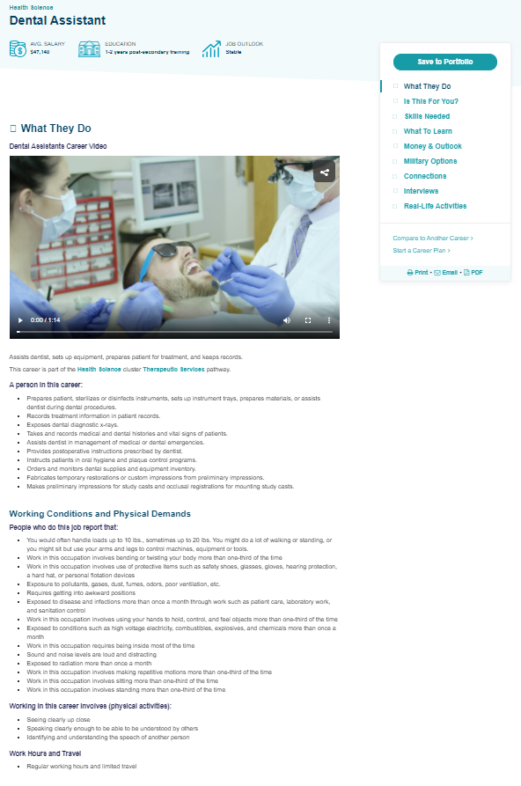
Career Exploration
What They Do
Make sure to watch the career profile video.

Slide 17
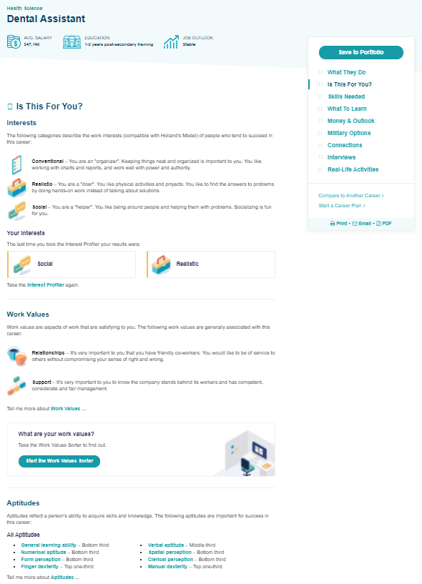
Is This For You?

Slide 18
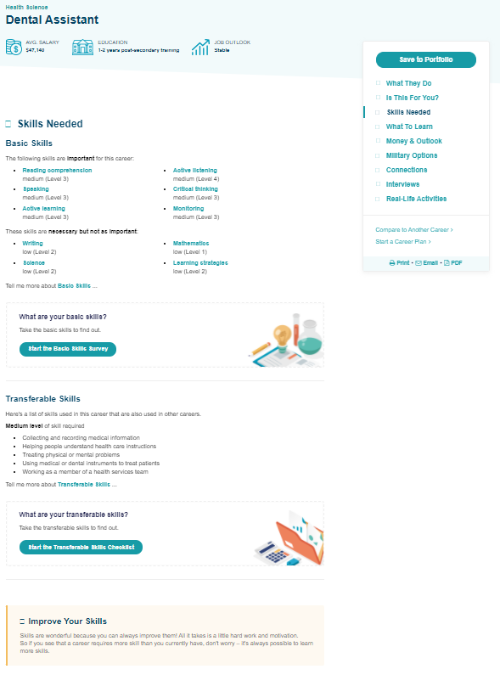
Skills Needed

Slide 19
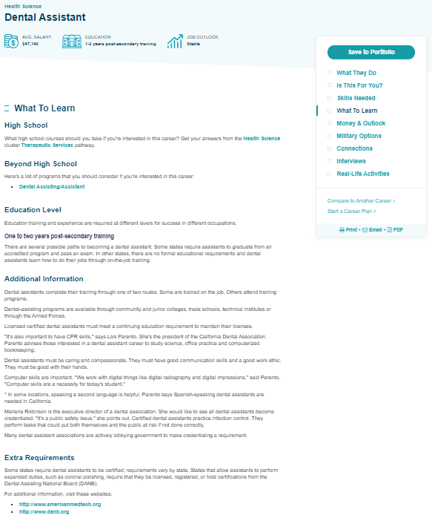
What To Learn

Slide 20
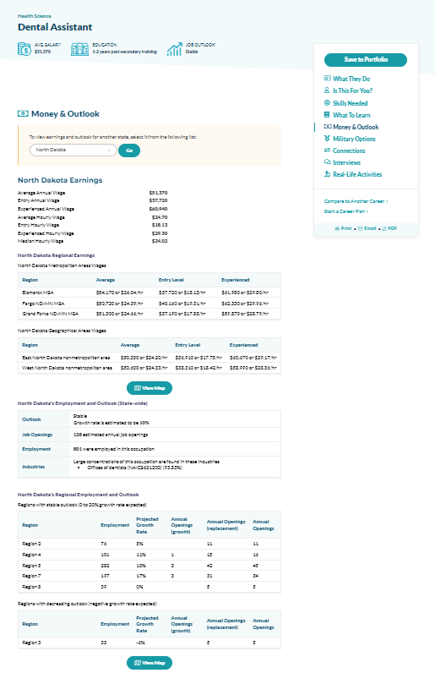
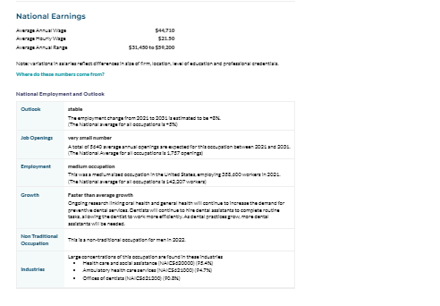
Money and Outlook

Slide 21
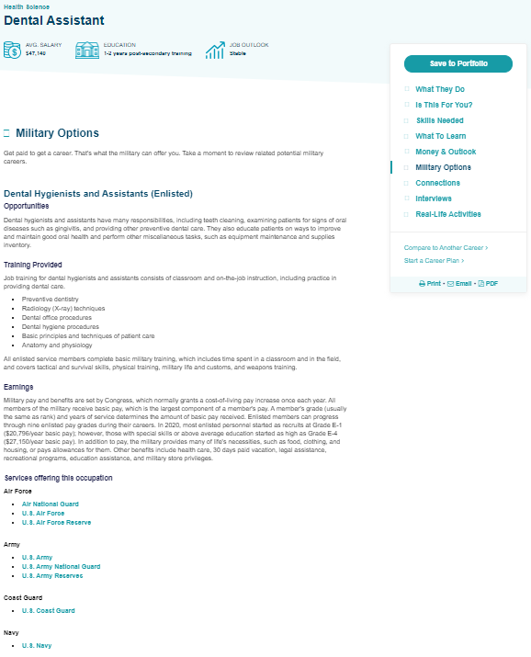
Military Options

Slide 22
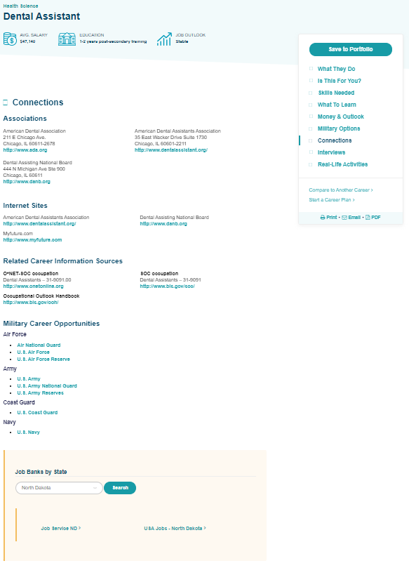
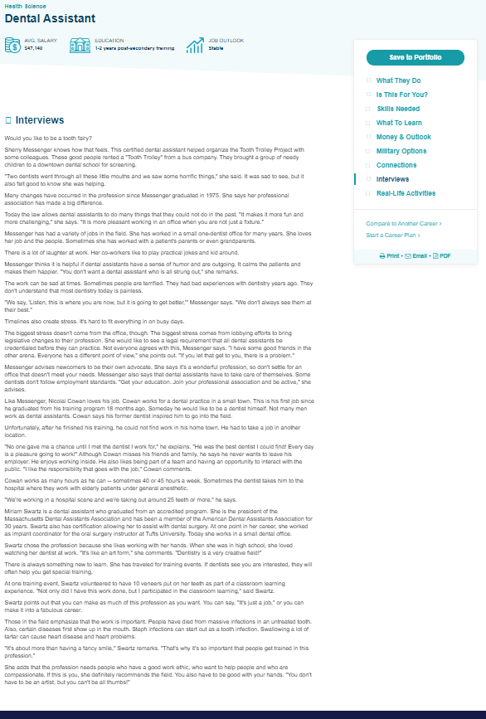
Connections
and
Interviews

Slide 23
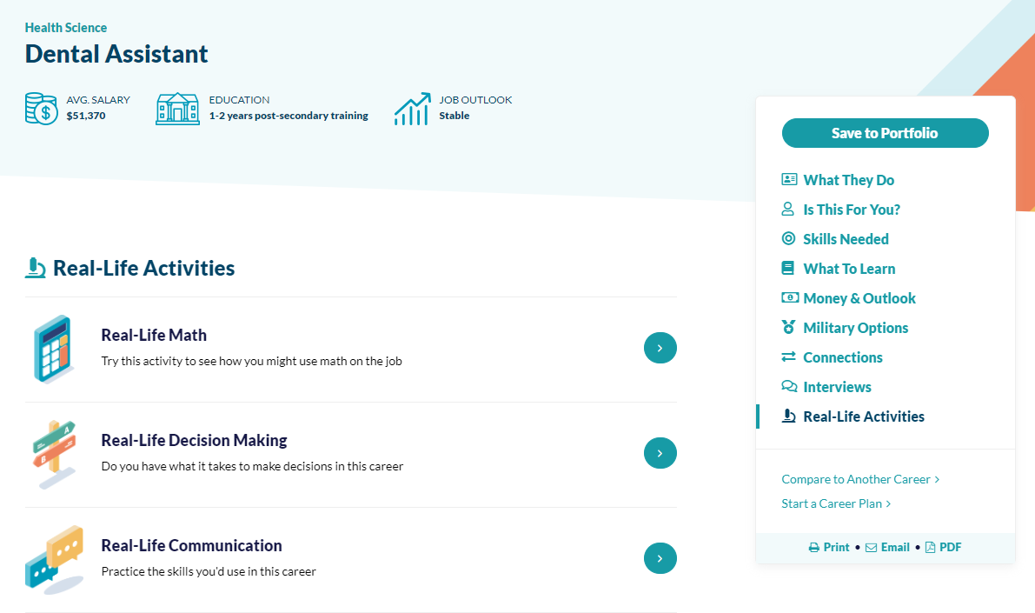
Practice with Real-Life Activies

Slide 24
Take-Away
Did you learn anything new about yourself?
How will you use this information in the future?

