Slide 1
Updated 9/7/2023
Explore Careers
and
Plan Your Future
With RUReady.ND.gov

Slide 2
How can I find out which careers might match my interests?
You can start by going to RUReady.ND.gov and taking the Career Cluster Survey!
What is RUReady.ND.gov?
RUReady.ND.gov is an education and career planning program available to everyone in North Dakota – from pre-K to adult!
What are Career Clusters?
Career Clusters are broad groups of occupations and industries that share common features.
If you like one job in a cluster, you will probably find other jobs in that cluster that you will like as well.
Careers with the same knowledge and skills are grouped in the same cluster.
Each cluster may include hundreds of different careers.

Slide 3
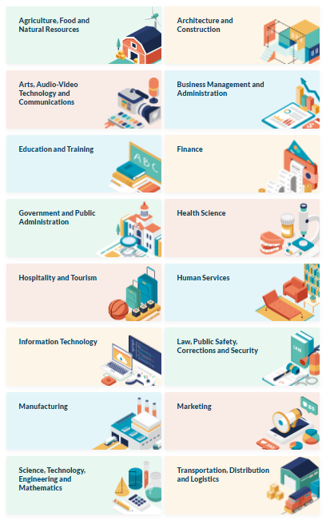
There are 16 Career Clusters
Agriculture, Food & Natural Resources
Architecture & Construction
Arts, Audio/Video Technology & Communications
Business, Management & Administration
Education & Training
Finance
Government & Public Administration
Health Science
Hospitality & Tourism
Human Services
Information Technology
Law, Public Safety, Corrections & Security
Manufacturing
Marketing, Sales & Service
Science, Technology, Engineering & Mathematics
Transportation, Distribution & Logistics

Slide 4
Benefits of Career Clusters
Why use career clusters to explore careers and plan your future?
Thinking ahead and preparing for careers is helpful if you are headed to the workplace or college. Some careers that are common today may not be needed tomorrow. And all careers require flexibility, knowledge, and skills.
Think big. Career clusters help you take a broad look at your options through six career fields and the options within each field.
Get excited. Choices seem endless but remember you're in control. Exploring clusters can get you excited about your options as you discover what's best for you.
Save time. Exploring groups of similar occupations helps you select and eliminate choices more quickly than researching many individual occupations.
Spend wisely. Make wise decisions about what you're going to study. Don't declare a major quickly and then realize halfway through the program that a different career interests you more.
Take control. Base your career choice on your own dreams and interests. Career clusters help you learn about all the types of careers available, so you don't leave the decision to chance.
Stand out. Grab employers' attention by knowing the skill requirements and knowledge for specific fields and jobs.

Slide 5
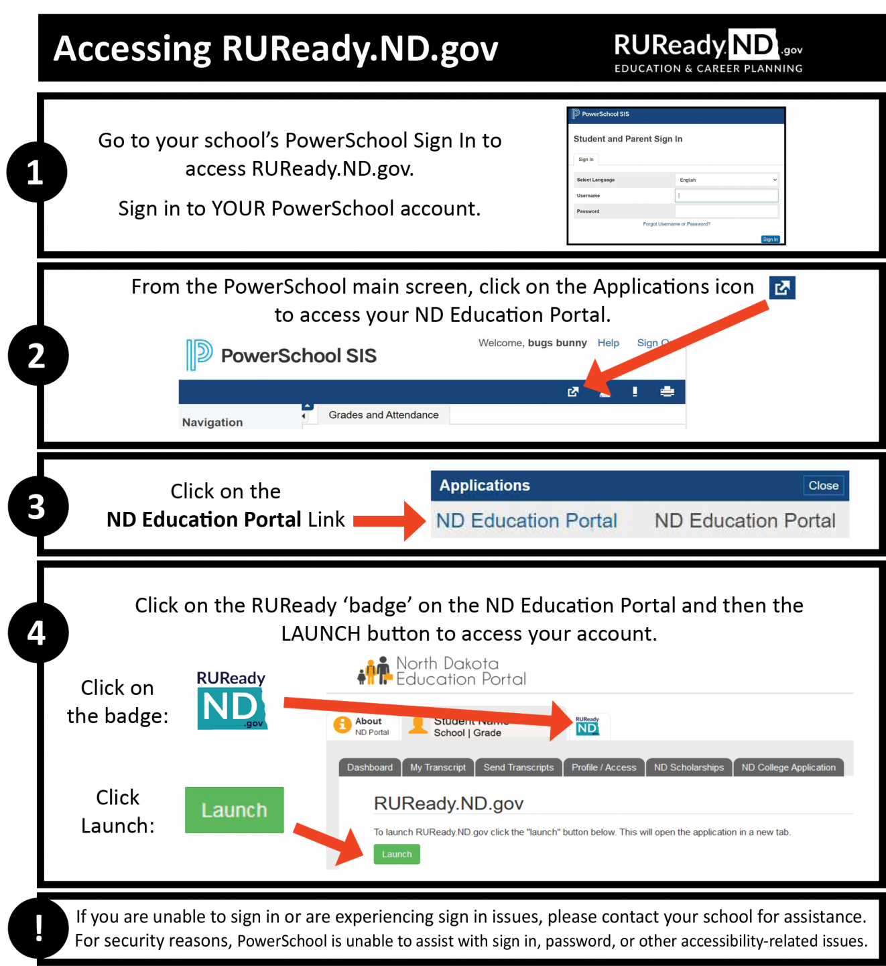
How do I access RUReady.ND.gov?
PUBLIC SCHOOL student in grades 6-12:
I’m a PRIVATE or TRIBAL SCHOOL student in grades 6-12:
Go to RUReady.ND.gov.
Click Create an Account.
Click on the role that best describes you (Middle School or High School Student.)
Enter your name and date of birth and select your school and graduation year.
Select your Account Name and Password with care. You will use this to access the site.
Complete the Account Security questions.
Check the box if you agree to the privacy policy and terms of the site.
Click Submit.
Full Instructions for Public School students. | Full Instructions for Private/Tribal School students.
Notes:
*If you are experiencing sign in issues, please contact your school for assistance. For security reasons, PowerSchool is unable to assist with sign in, password, or other accessibility-related issues.
(You will receive your account username and password from your school.)

Slide 6
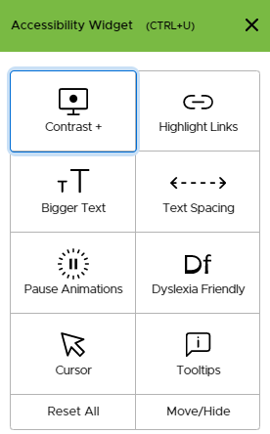
The UserWay Widget
The UserWay widget offers assistance with the following:
Contrast
Highlight Links
Bigger Text
Text Spacing
Pause Animations
Dyslexia Friendly
Cursor
Tooltips
Click on the green UserWay icon in the in upper right-hand corner of the screen to select accessibility tools.
Notes:
Mention this feature if you have students who would benefit from it.

Slide 7
Find the Career Cluster Survey
Click on the CAREER PLANNING tab.

Slide 8
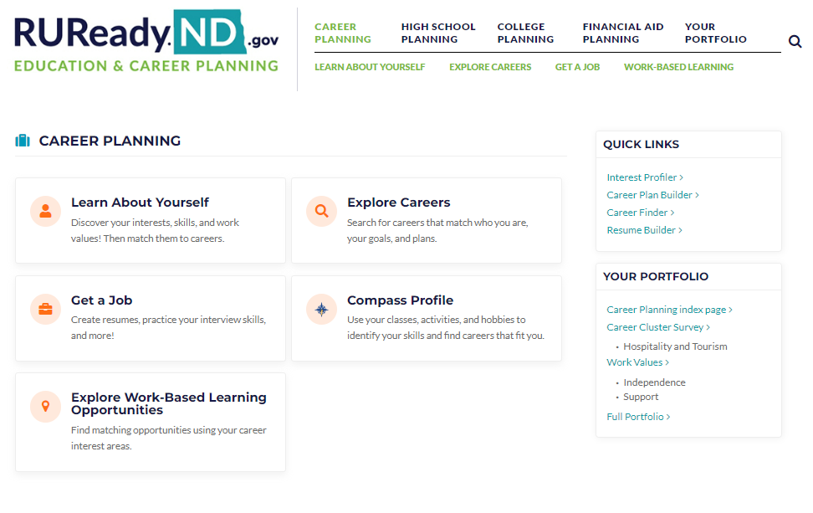
Click on Learn About Yourself.

Slide 9
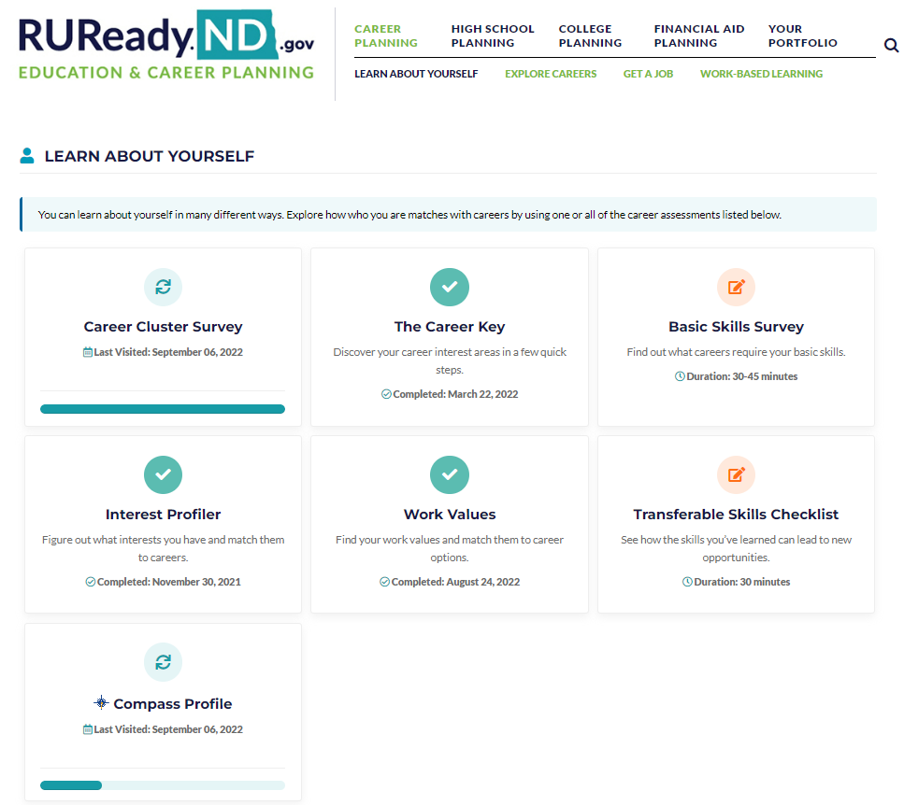
Click on Career Cluster Survey

Slide 10
Click START

Slide 11
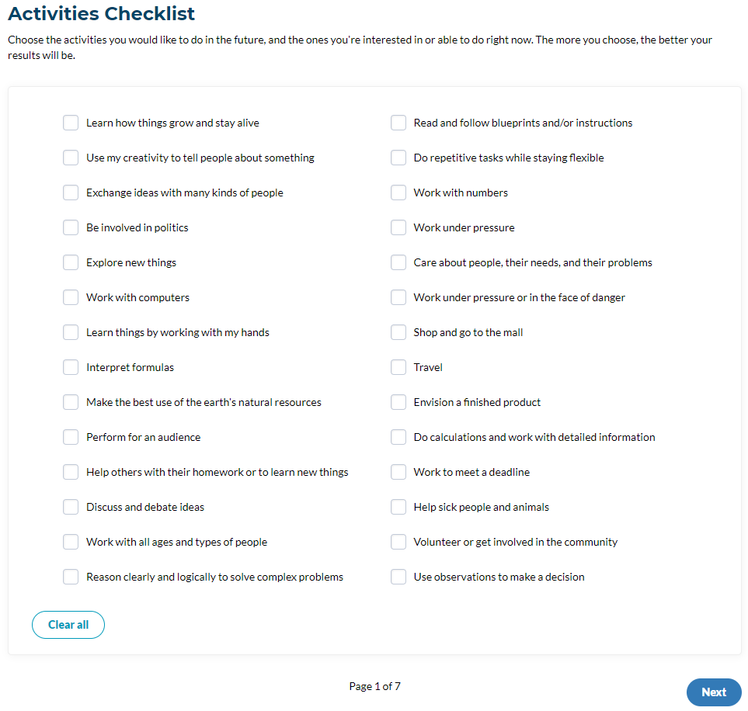
Check ✓all of the activities you would like to do in the future or right now.
Click Next at the bottom.
There are 7 pages to the Career Cluster Survey.

Slide 12
Here is some vocabulary you may want to know before moving to the next section of checklists:
Inquisitive – eager for knowledge, curious
Tactful – skill in handling difficult situations
Keen – smart, sharp
Rational – reasonable, good sense
Methodical – orderly, careful
Civic-minded – want to make a difference in community
Impartial – fair, not favoring one idea or person
Diplomatic – skilled in handling sensitive information
Perceptive – recognize/identify behaviors, problems, concerns
Analytical – you can break down information & examine parts
Find more definitions of terms used in the Career Cluster Survey here.

Slide 13
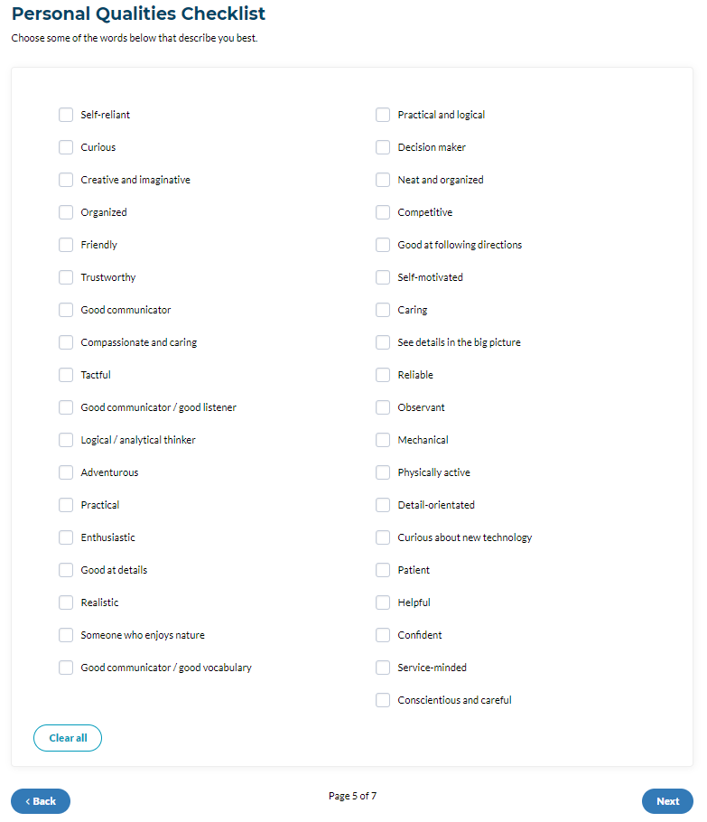
Check ✓ all of your personal qualities.
Click NEXT
at the bottom.

Slide 14
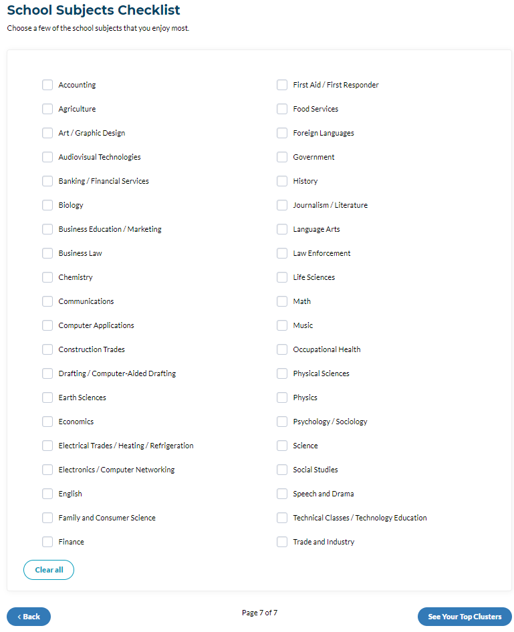
Check ✓ all of the school subjects you like or enjoy.
Click SEE YOUR TOP CLUSTERS at the bottom.

Slide 15
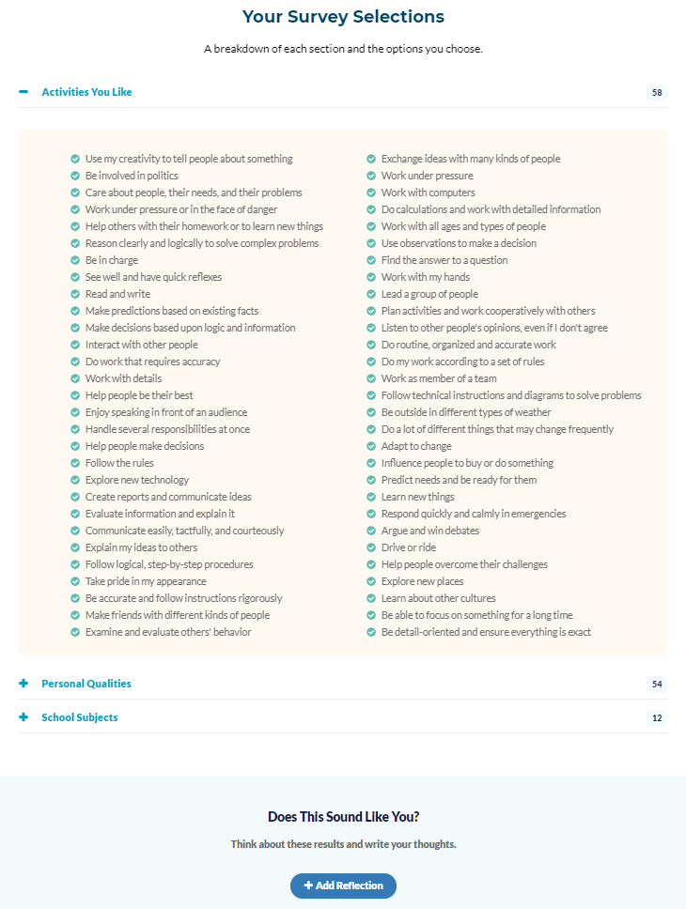
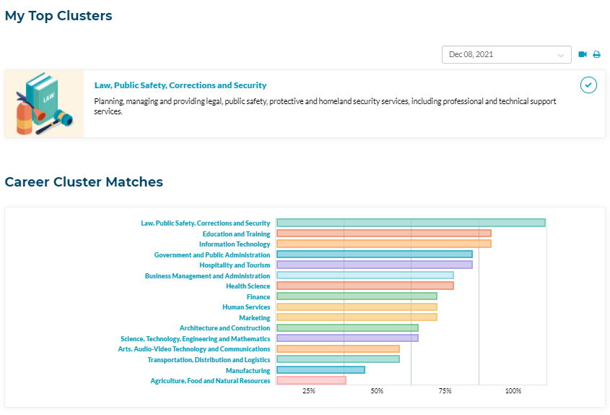
Your Results
Click on your top clusters to learn more about the cluster and view a list of matching careers.
Add Reflection

Slide 16
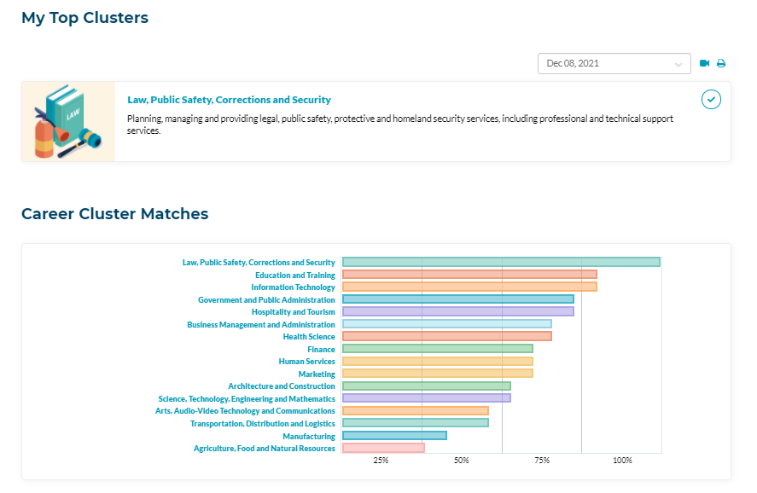
Click on One of Your Top Career Clusters

Slide 17
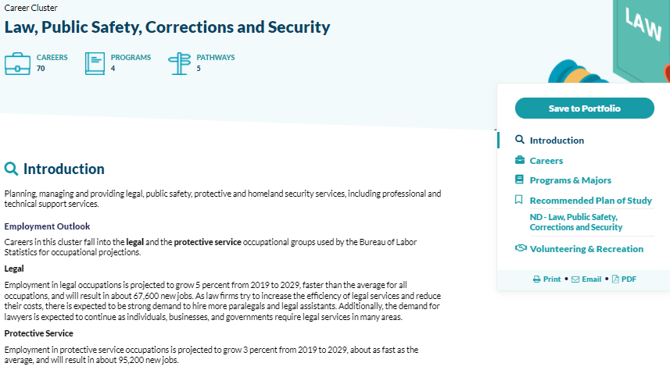
Click Save to Portfolio
Click Careers

Slide 18
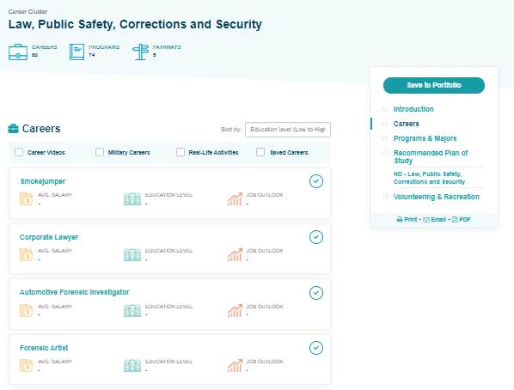
Sort by Education Level
Professional or Graduate Degree
= 6+, 8+, or 12-16+ years of college
Bachelor’s Degree
= 4 years of college
Associate’s Degree
= 2 years of college
Postsecondary training
= some college with on-the-job training
Military

Slide 19
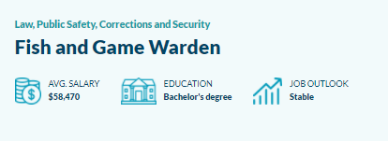
If available, watch the career video. Choose items from the menu on the right to learn more about the career.
Notice the information at the top:
Average Salary
Education
Job Outlook

Slide 20
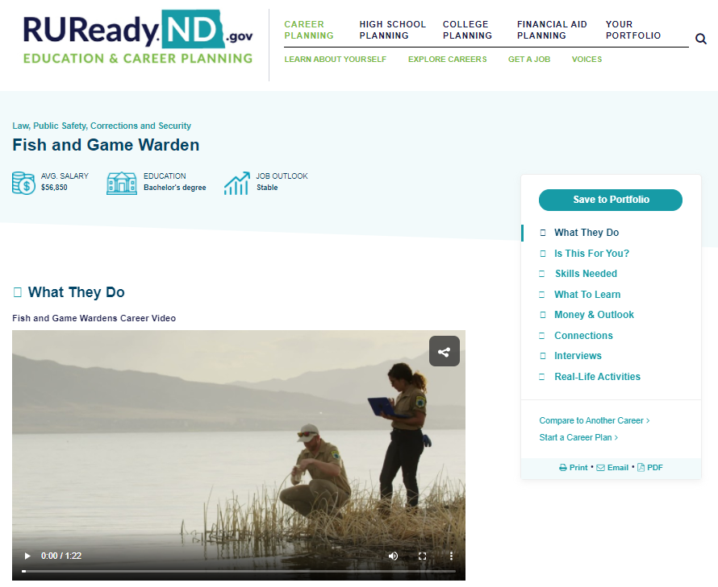
Your Portfolio

Slide 21
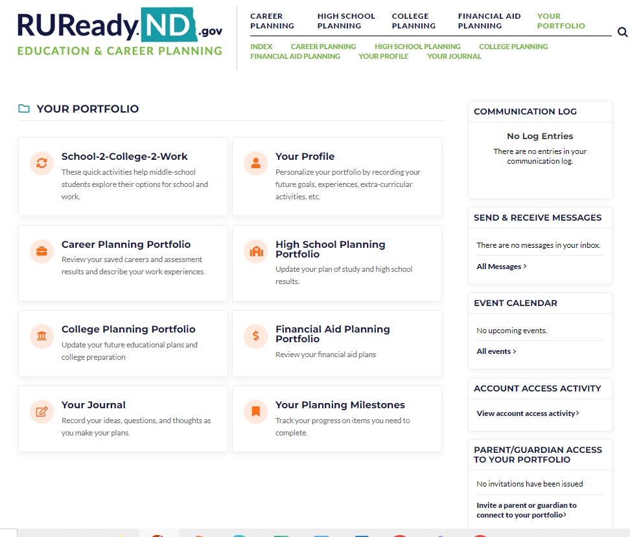
Your Journal

Slide 22
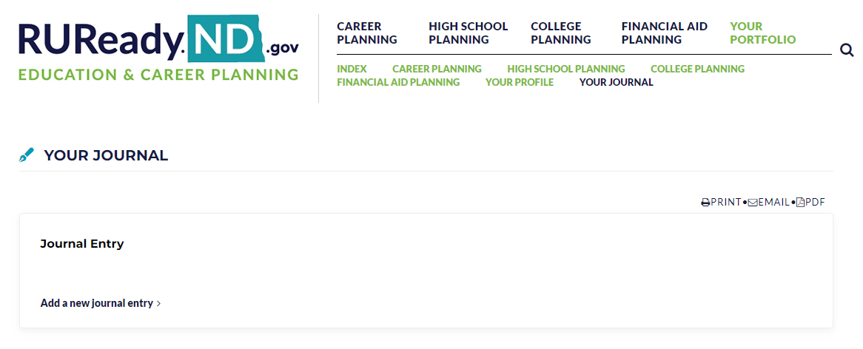
Add a new journal entry

Slide 23
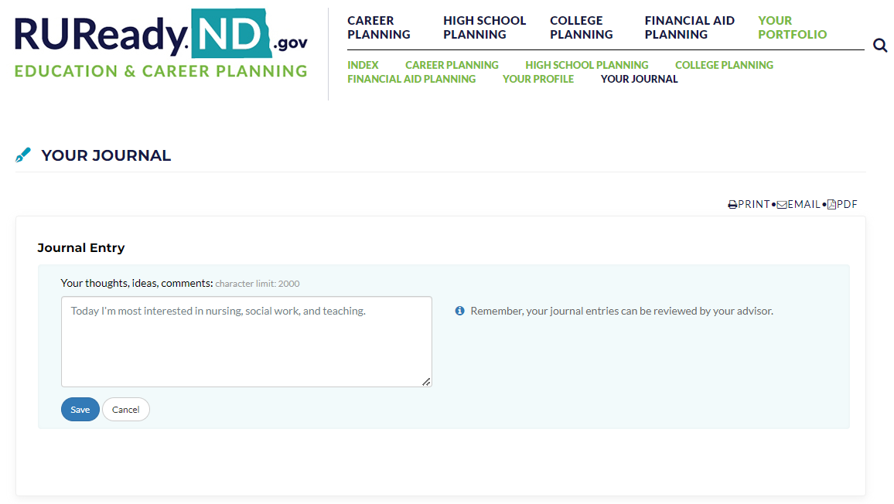
Example journal entry:
Click Save!

Slide 24
Take-Away
Did you learn anything new about yourself?
How will you use this information in the future?

