Slide 1
Explore Careers
and
Plan Your Future
With RUReady.ND.gov
The Career Key

Slide 2
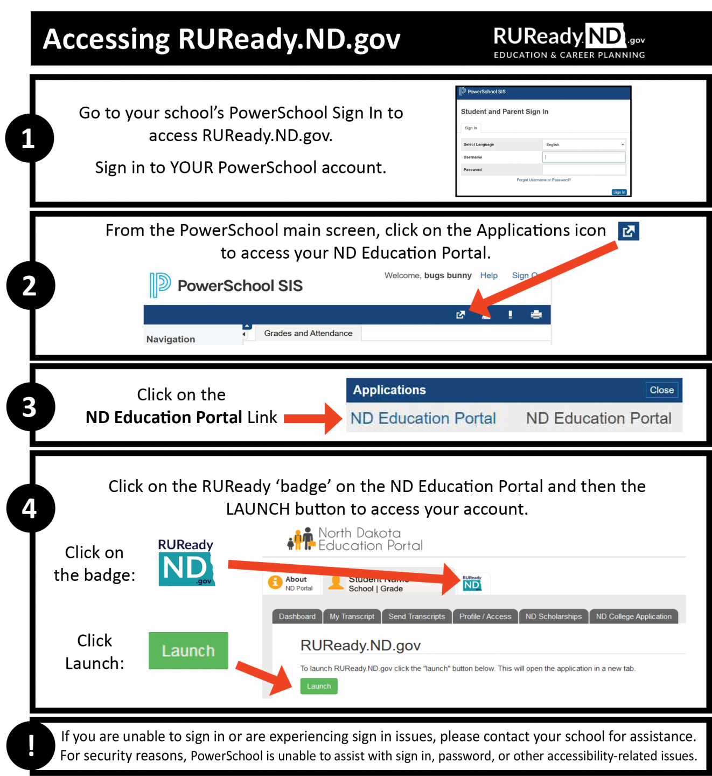
1. How do I access RUReady.ND.gov?
I’m a PUBLIC SCHOOL
student in grades 6-12:
I’m a PRIVATE or TRIBAL SCHOOL
student in grades 6-12:
Go to RUReady.ND.gov.
Click Create an Account or sign in to your account.
Click on the role that best describes you (Middle School or High School Student.)
Enter your name and date of birth and select your school and graduation year.
Select your Account Name and Password with care. You will use this to access the site.
Complete the Account Security questions.
Check the box if you agree to the privacy policy and terms of the site.
Click Submit.
Full Instructions for Public School students. | Full Instructions for Private/Tribal School students.
Notes:
*If you are experiencing sign in issues, please contact your school for assistance. For security reasons, PowerSchool is unable to assist with sign in, password, or other accessibility-related issues.
(You will receive your account username and password from your school.)

Slide 3
The UserWay Widget Provides Keyboard navigation, Contrast, Highlight links, Bigger text, Text spacing, Pause animations, Legible fonts and Cursor. (Enable by clicking on the green icon in the upper right-hand corner.)
Notes:
Mention this resource if you have students who may benefit. The UserWay accessibility widget provides helpful accessibility tools and site modification options for users requiring accessibility enhancements.

Slide 4
2. Click on CAREER PLANNING

Slide 5
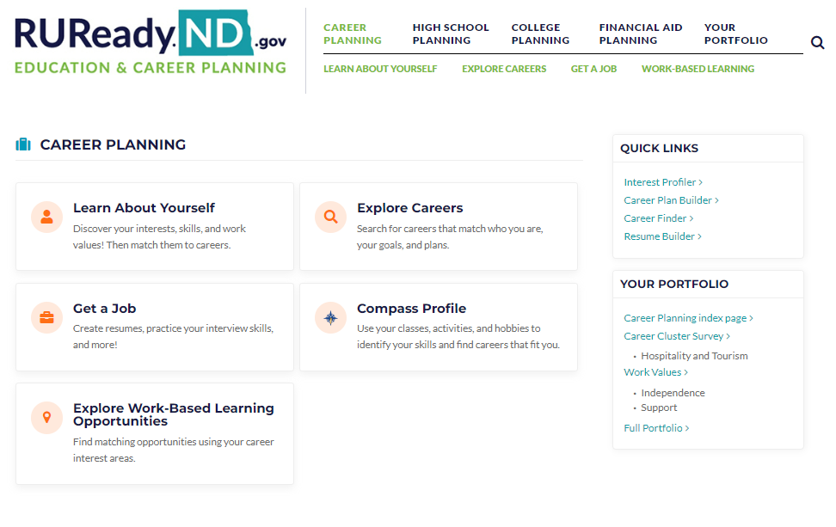
3. Click on Learn About Yourself

Slide 6
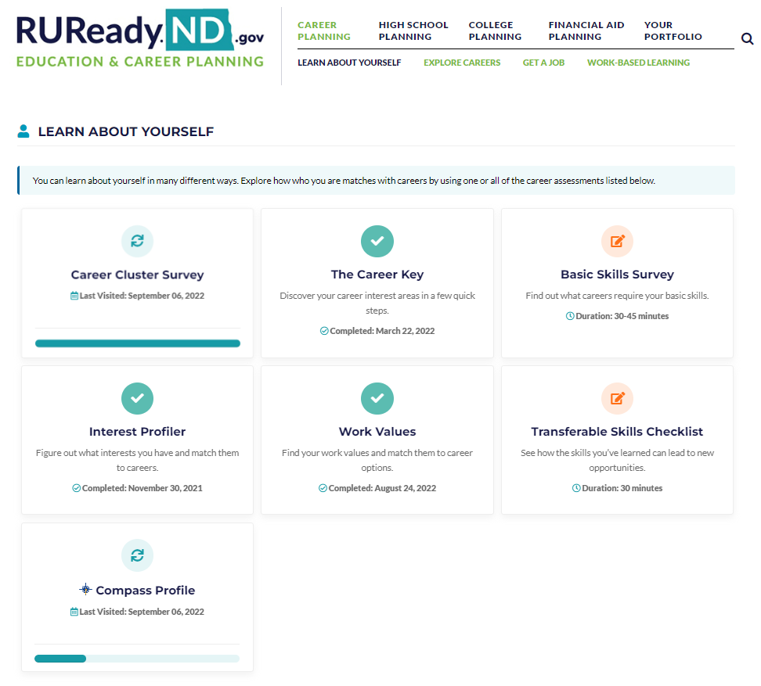
4. Click on The Career Key

Slide 7
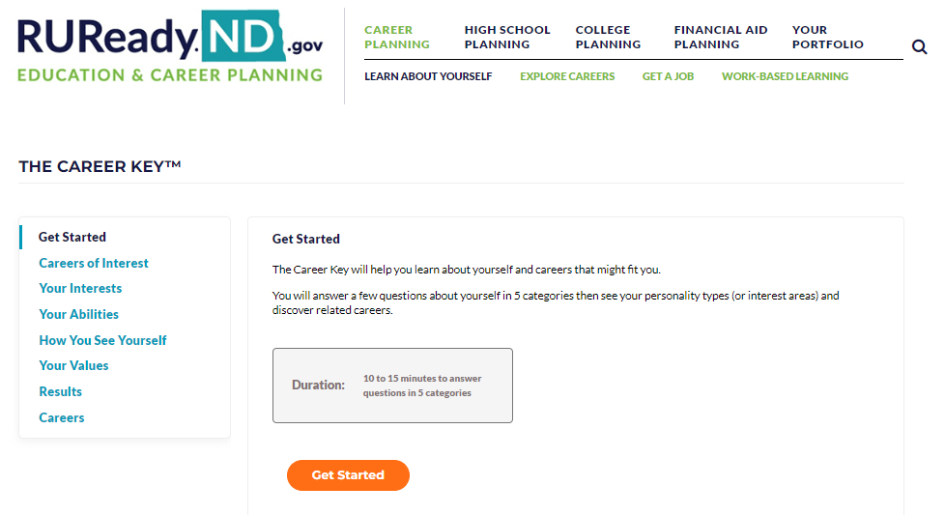
5. Click on Get Started

Slide 8
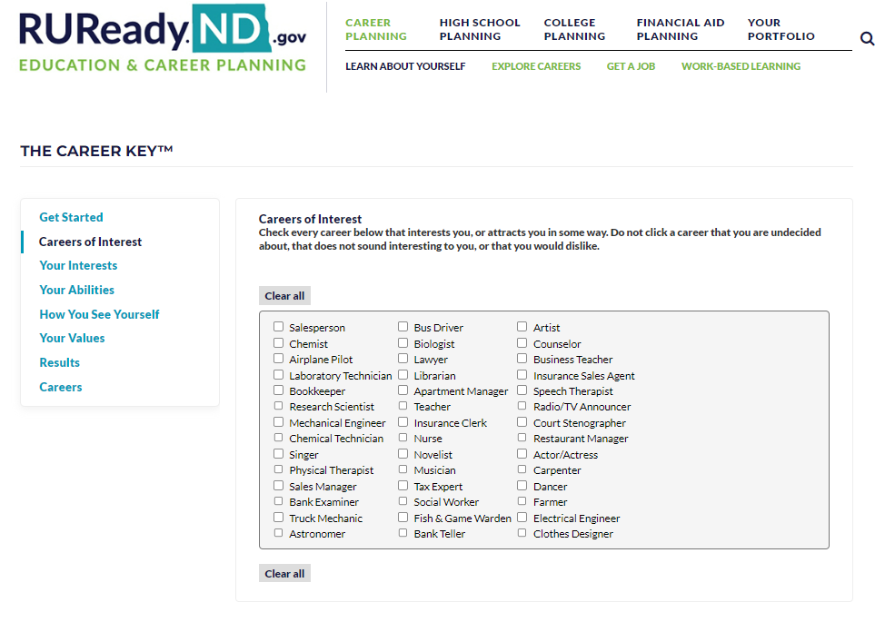
6. Complete the checklists. Choose the careers that interest you.

Slide 9
What are your interests?

Slide 10
What are your abilities?

Slide 11
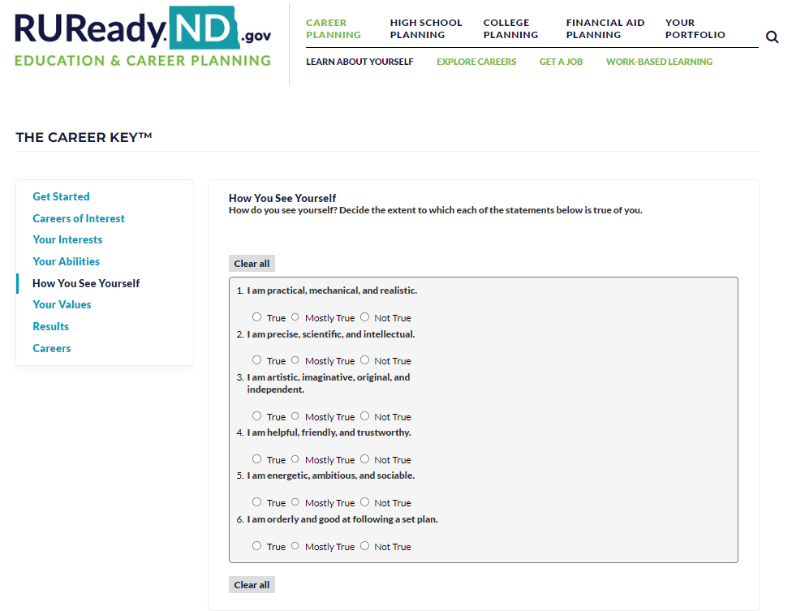
How do you see yourself?

Slide 12
What are your values?

Slide 13
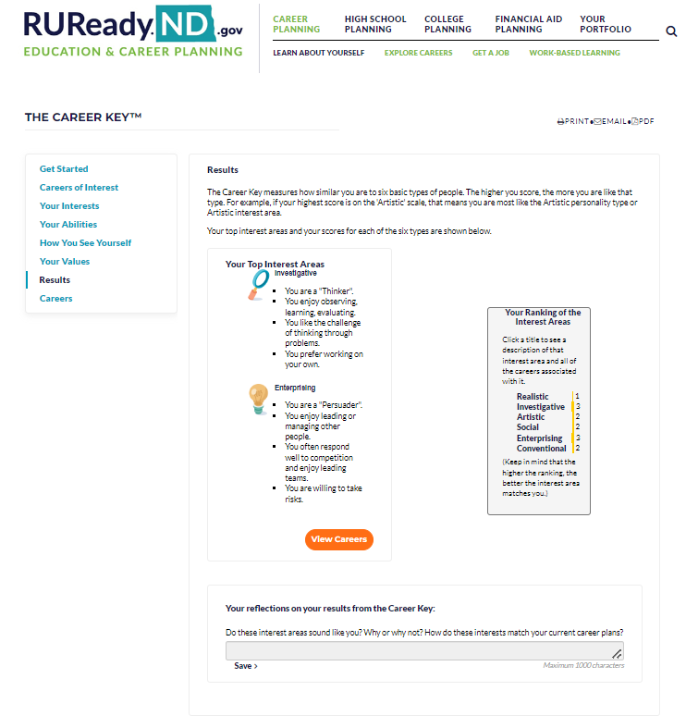
Read through your results. What are your top two Interest Areas?
Click View Careers to see careers that match your results.
Write a reflection at the bottom of the page.

Slide 14
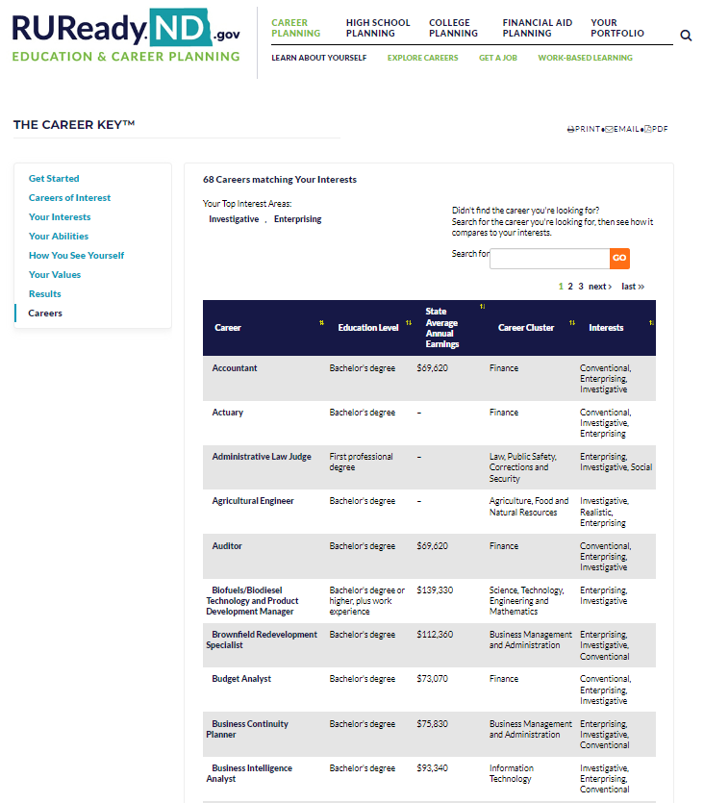
Research matching careers using the search tools:

Slide 15
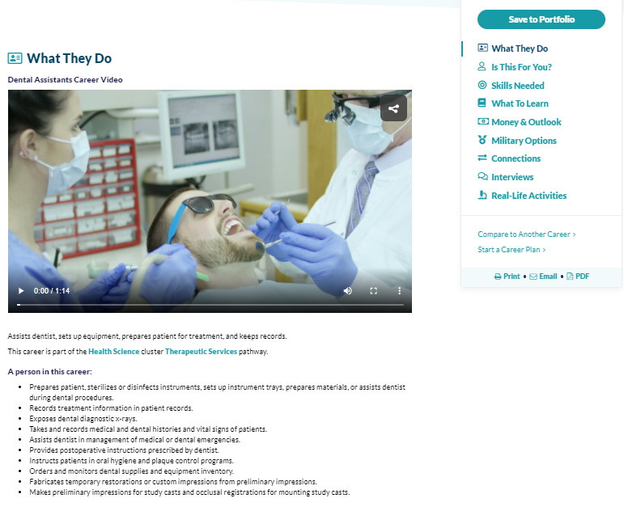
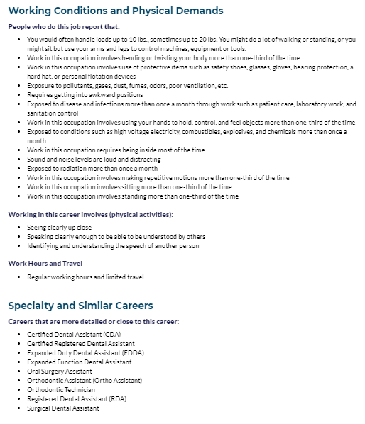
Career Exploration: Dental Assistant

Slide 17
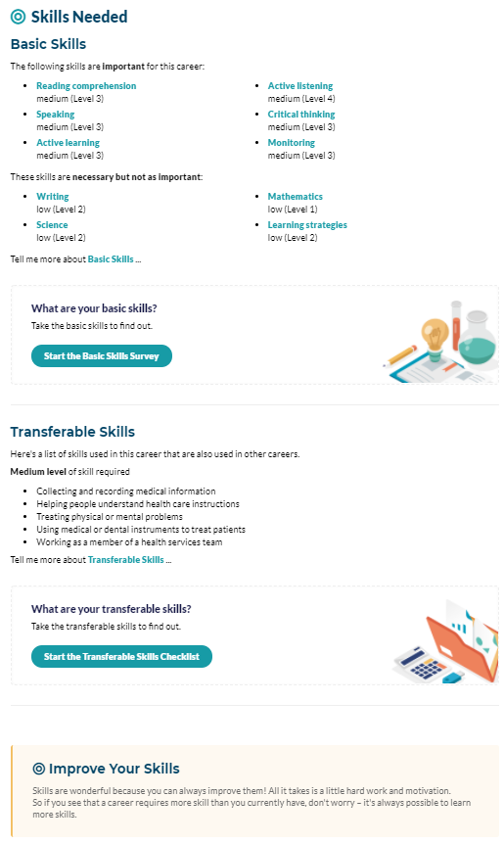

Slide 18
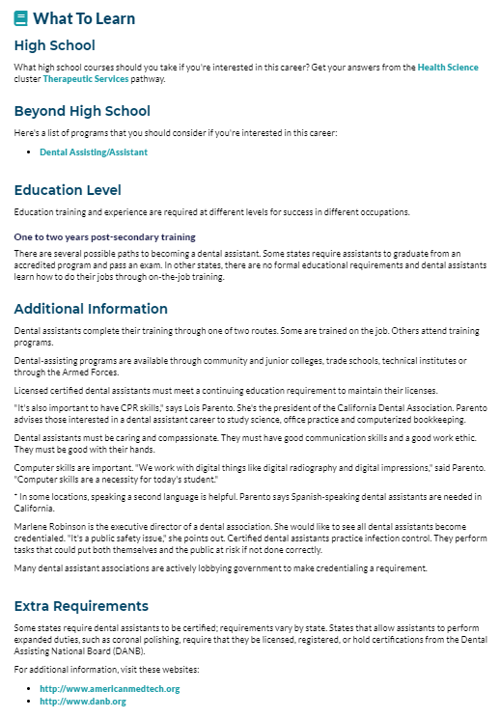

Slide 19
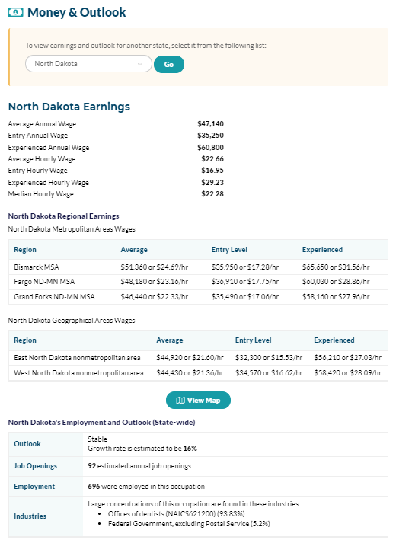
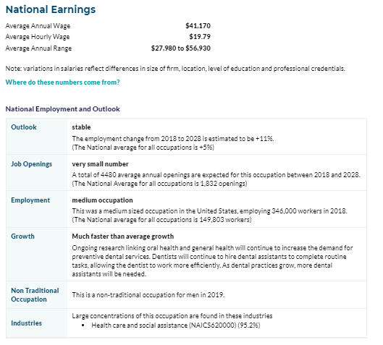

Slide 20
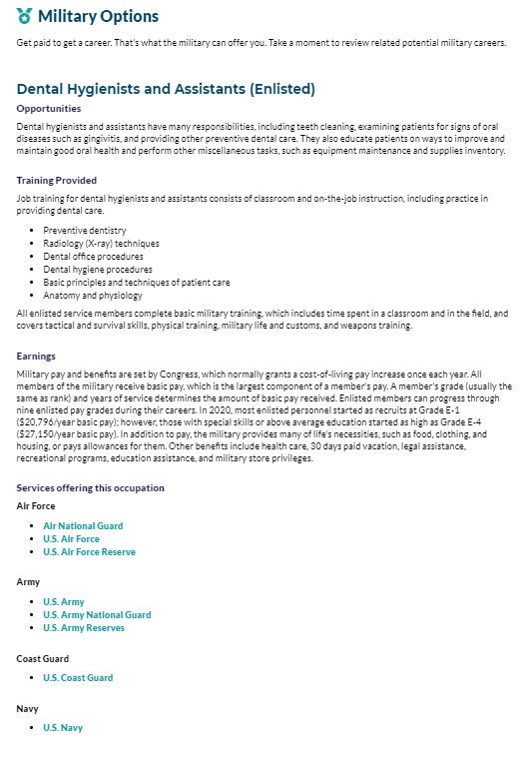

Slide 21
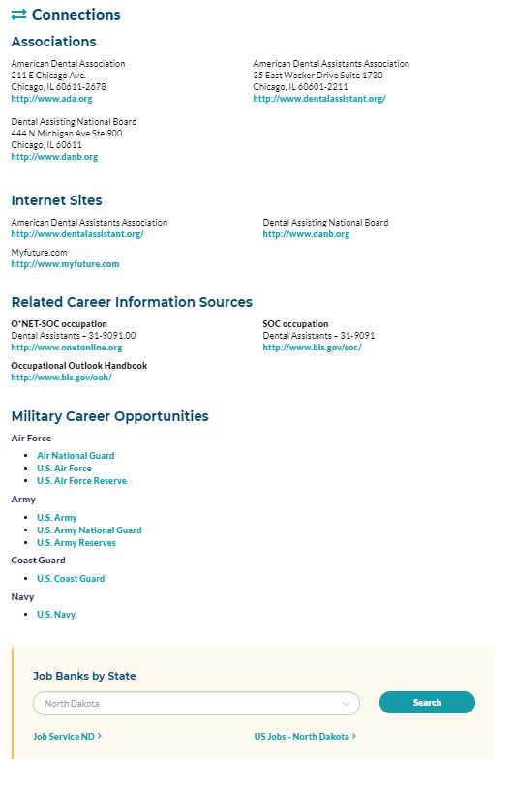

Slide 22
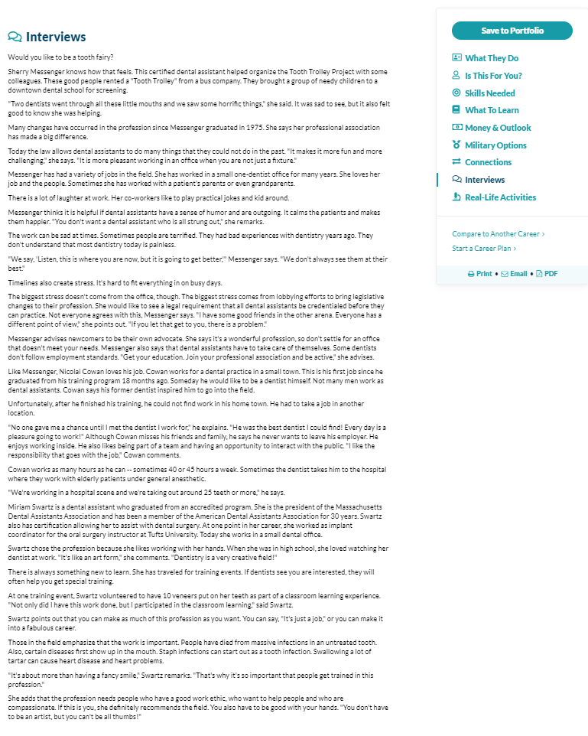

Slide 23
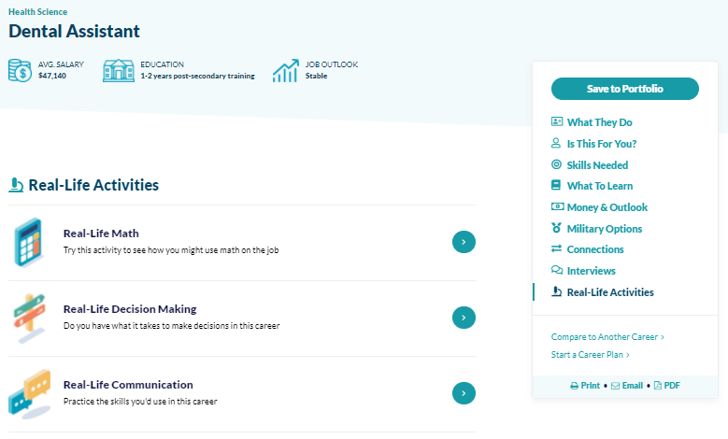

Slide 24
What questions do you still have?

